Slide 1

Business Opportunities with Wiltshire Council

Slide 2
Housekeeping
Please put phones on silent throughout the presentation
We will take questions at the end
We encourage you to provide feedback after this presentation
A PDF copy of the presentation will be available after today
Procurementunit@wiltshire.gov.uk

Slide 3
Agenda
Introductions
What Wiltshire Council purchases
Regulatory Considerations
E Tendering
Questions
Networking
Procurementunit@wiltshire.gov.uk

Slide 4
Jargon Busting
Public Contract Regulations 2015 (PCR 2015)
Find a Tender Service (FTS)
Term Contracts
Frameworks
Dynamic Purchasing Systems (DPS)
Spot Purchase/One off
RFQ/ITT
Procurementunit@wiltshire.gov.uk

Slide 5

£456,658,458.23

Slide 6

£101,638,903.75

Slide 7
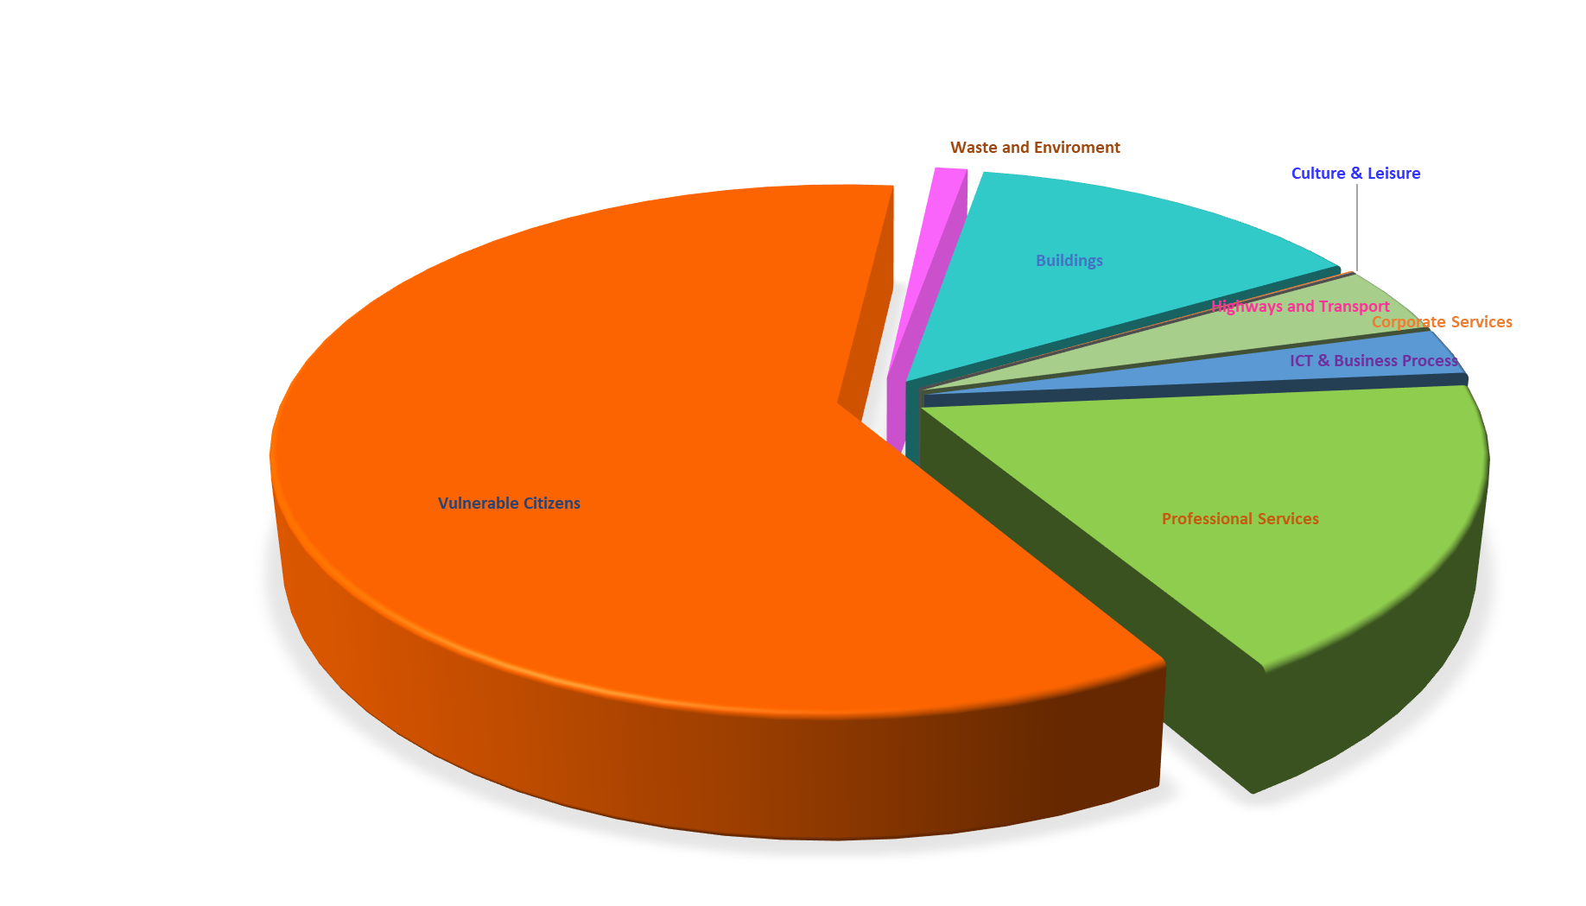
SME Spend Category’s
Procurementunit@wiltshire.gov.uk

Slide 8
What do we buy?
Social Care Services (adults and children)
Construction (housing and infrastructure)
Maintenance (vehicles, housing, pool side equipment)
Waste Collection (and the wheelie bin you have at home)
Printing, consultancy, IT, body bags, fridges, street lighting
Procurementunit@wiltshire.gov.uk

Slide 9
Frameworks & Dynamic Purchasing Services
Wiltshire Home Care Flexible Framework
Childrens Home Care Flexible Framework
Passenger Transport DPS
GPs and Pharmacy DPS
Procurementunit@wiltshire.gov.uk

Slide 10

Types of Opportunity
FTS Open Tenders
Public Contract Regulations 2015
Large contracts and in many cases of a high value
Will (in many cases) have subcontracting arrangement
RFQs
Smaller opportunities that have a value under £177,000
Simple, quick and conducted in line with the Council’s Constitution and applicable policy
Procurementunit@wiltshire.gov.uk

Slide 11
Benefits of Working for the Council
Assured Payment within thirty days
Can help with banks and securing additional finance
Gives other potential customers assurance
Can lead to additional work
Procurementunit@wiltshire.gov.uk

Slide 12
Here's where you find the opportunities
Wiltshire Council Future Pipeline
www.supplyingthesouthwest.org.uk
www.findatender.co.uk
www.gov.uk/contracts-finder
Procurementunit@wiltshire.gov.uk

Slide 13


Slide 14
Tips for RFQ’s and Tenders
Read all the documents
Identify the documents you need to return
Appoint a member of staff to be in charge of the tender submission
Use clarification questions when required
Answer the question
Only the documents listed to be returned can be evaluated
Do not use sweeping statements and generalisations

Slide 15
Tips for RFQ’s and Tenders
Tenders often do not win due to:
failing to answer the specific questions
failing to address the full specification
an insufficient level of detail
inability to evidence the required competencies
poor planning
non-compliance with eligibility criteria
Exceeding the word or page count
Procurementunit@wiltshire.gov.uk

Slide 16
Tips for RFQ’s and Tenders
Remember that:
a tender is a sales document
do not waste words on goods and services not specified in the requirement
its goal and purpose is to convince a decision maker that they should buy your solution
the aim is to sell, rather than report
Procurementunit@wiltshire.gov.uk

Slide 17
Tips for RFQ’s and Tenders
An example question: “Please provide your strategy for sourcing and recruiting subcontractors and for ensuring that you can effectively monitor, measure and exercise executive control”
You should respond by providing your strategy for:
sourcing subcontractors, how do you find them
recruiting subcontractors, what do you check and require
ensuring effective monitoring, regular meetings, spot checks
ensuring effective measuring, KPI’s, right first time, customer feedback
exercising executive control, effective contracts
Procurementunit@wiltshire.gov.uk

Slide 18
Your Thoughts
What can we do that will make it easier for you to do business
with us?
Procurementunit@wiltshire.gov.uk

Slide 19

Any Questions?

